Slide 1

Exam 2 Database
MentorShip

Slide 2
1. Topic 2. Database 3. Query

Slide 3
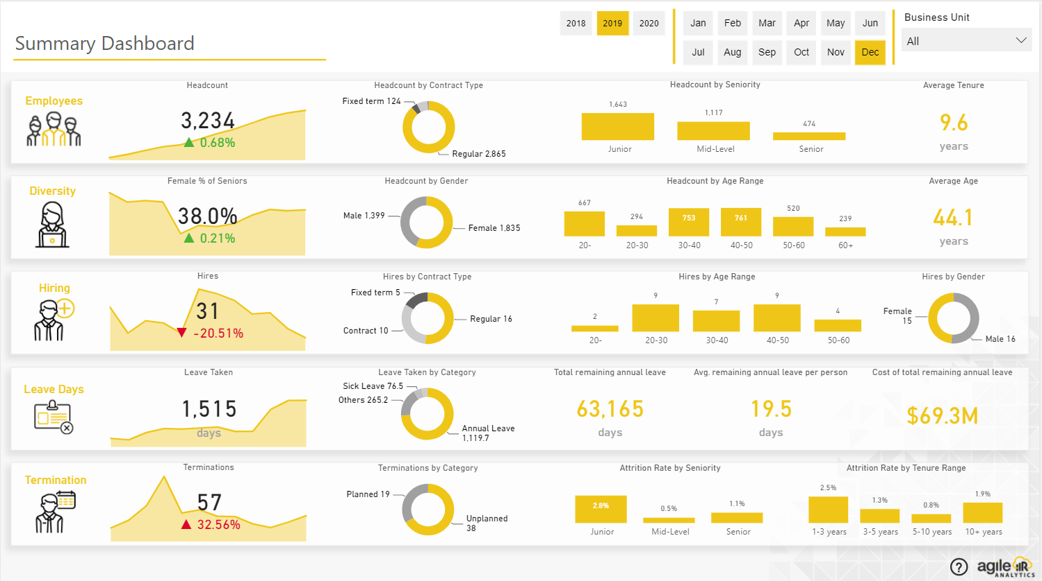
1. Topic

Slide 4
1.Topic
There are active year, month, and business filters applied across the entire query.
Main items on the page.

Slide 5
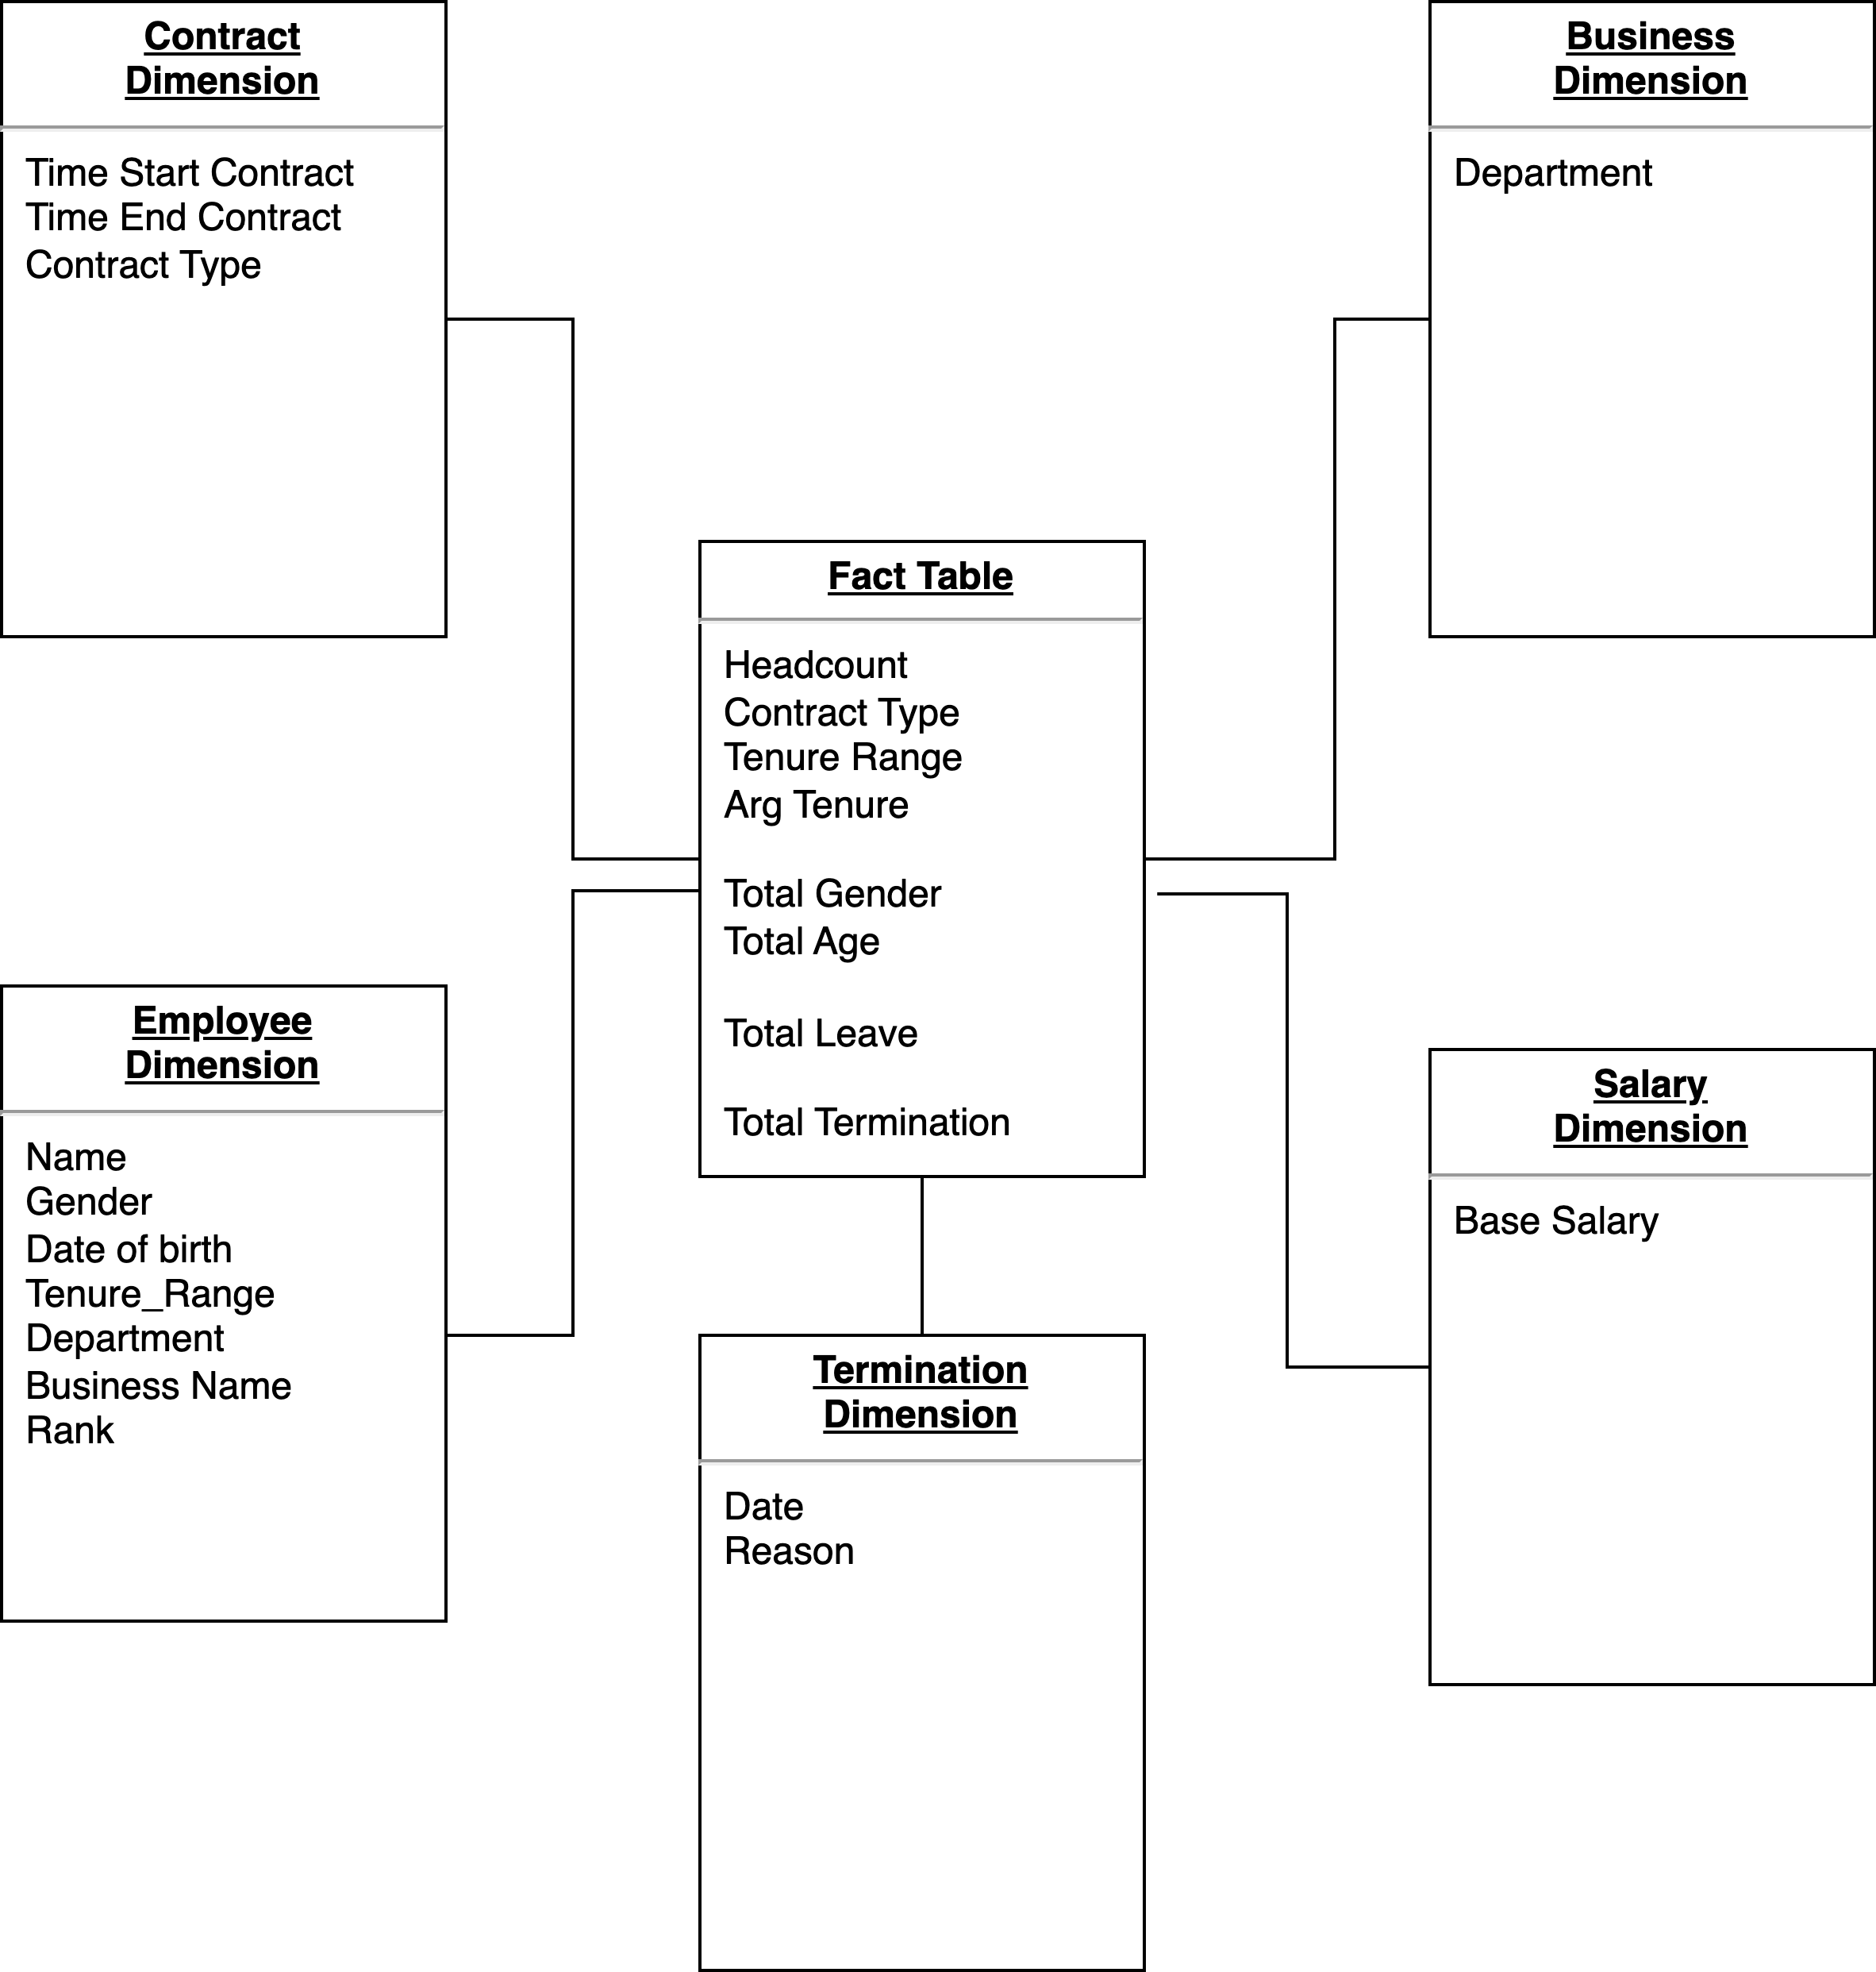
2. Database

Slide 6
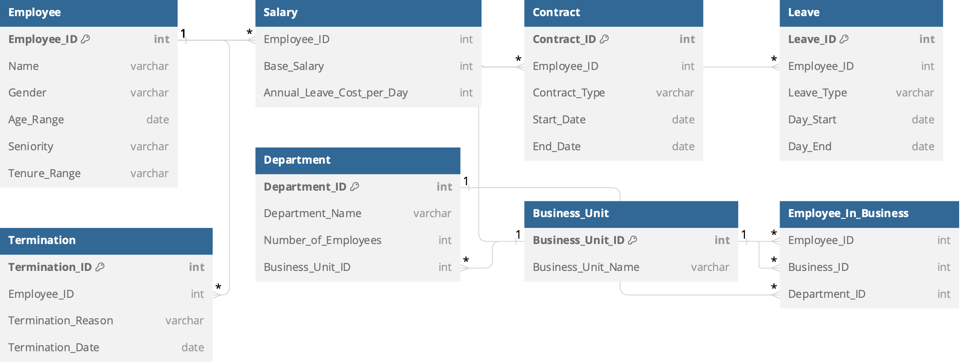
2. Database

